Slide 1
A8: High-fi Prototype
10/08
11/21
SparkBook

Slide 2
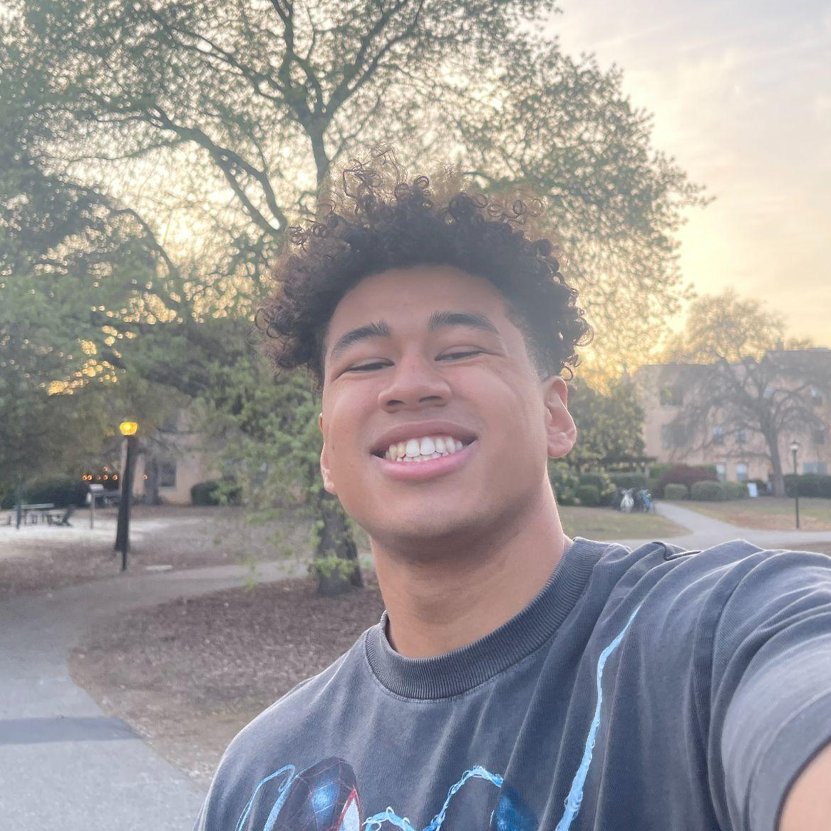



Team
Elijah
Luiza
Claire
Mikela
Symbolic Systems ‘26
Design + CS ‘28
Computer Science ‘27
Symbolic Systems ‘27

Slide 3

“Spark your creativity.”
Notes:
a. How did your team land on the name? b. One-liner value proposition that conveys what customers get out of your product (e.g., Stripe “Payment infrastructure for the Internet”) c. Sanity check: could your value proposition be applicable to many other apps or is it particular to yours? You want the latter.

Slide 4
Index
1
2
3
4
Problem and Solution
Heuristic Evaluation
Results
Revised UI Designs
Hi-Fi Prototype & Demonstration

Slide 5
Problem
Solution
SparkBook
Artists struggle to effectively and quickly store all of their various sources of inspiration in a centralized and organized structure. This makes it harder for them to go back to these sources when they are creating art.
A digital notebook that allows artists to store multimedia sources of inspiration while smarty organizing them based on their chosen categories.

Slide 6
Heuristic Evaluation Results

Slide 7
Heuristic Evaluation Overview
96
Total violations
1. Severity breakdown
2. Heuristic breakdown
3. Takeaways
High-level summary of results: total violations, severity breakdown, most common violations, total number of UI revisions needed to be made based on the major severity 3 & 4 violations as well as any severity 1 & 2 violations deemed necessary
Consider communicating your results through a visual representation of these statistics and reflecting on how these high-level trends informed your approach to addressing the violations

Slide 8
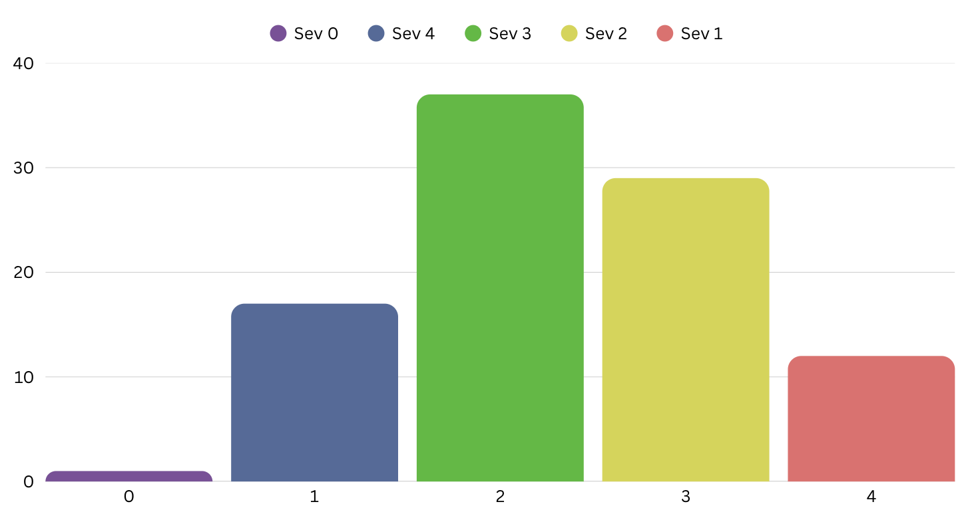
Severity Overview
37
29
17
13
1
High-level summary of results: total violations, severity breakdown, most common violations, total number of UI revisions needed to be made based on the major severity 3 & 4 violations as well as any severity 1 & 2 violations deemed necessary
Consider communicating your results through a visual representation of these statistics and reflecting on how these high-level trends informed your approach to addressing the violations

Slide 9
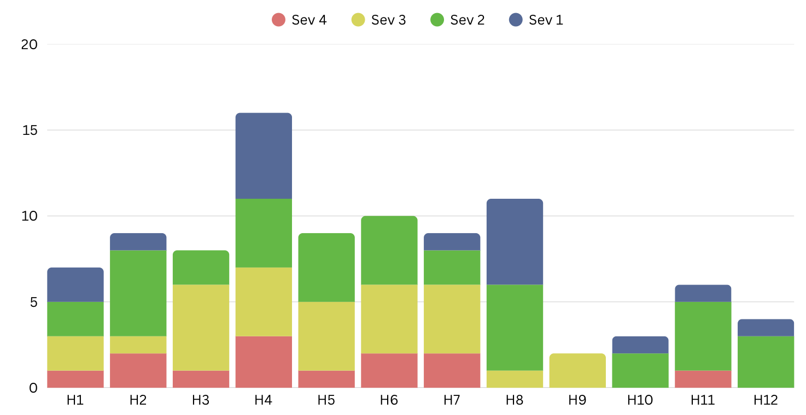
Heuristics Overview
16
11
10
High-level summary of results: total violations, severity breakdown, most common violations, total number of UI revisions needed to be made based on the major severity 3 & 4 violations as well as any severity 1 & 2 violations deemed necessary
Consider communicating your results through a visual representation of these statistics and reflecting on how these high-level trends informed your approach to addressing the violations

Slide 10
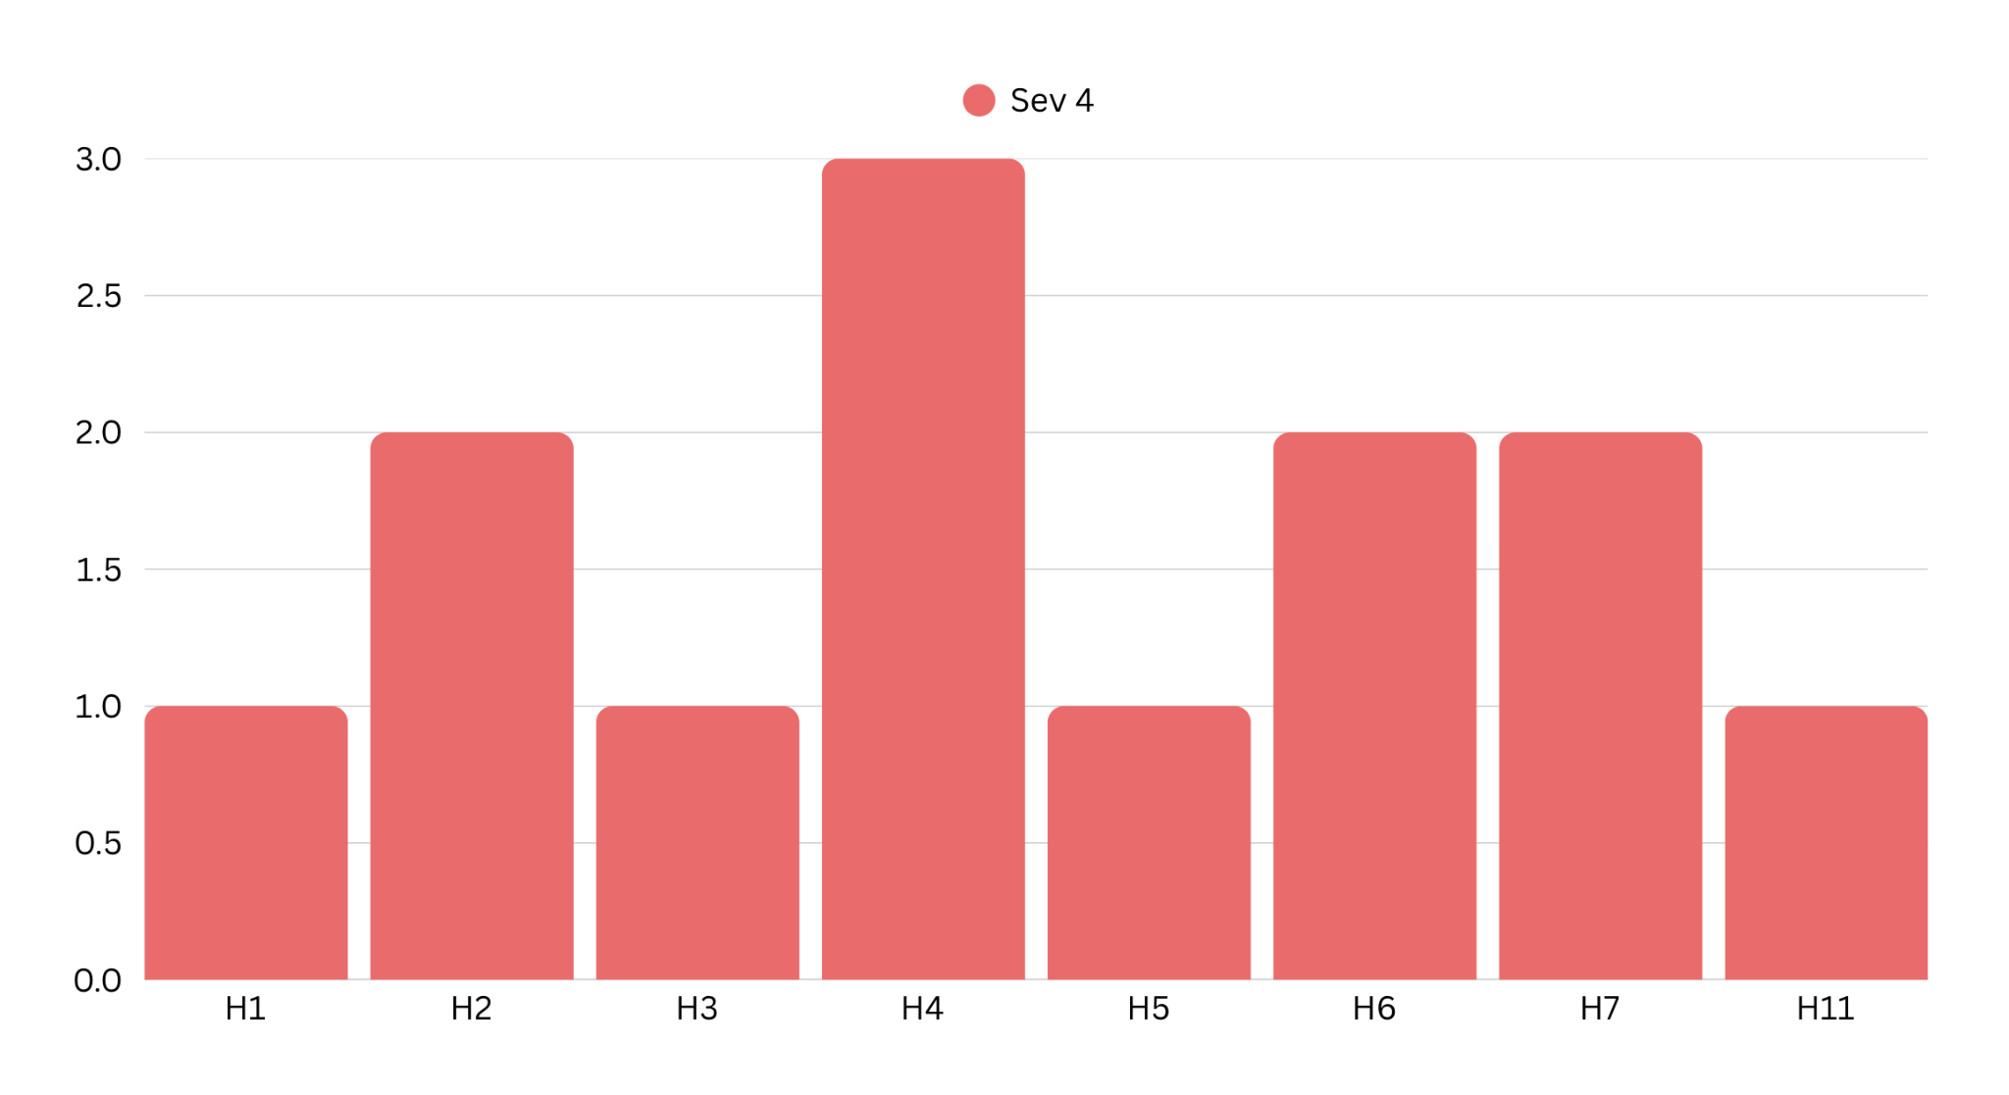
Severity 4 trends
Severity 4
12

Slide 11
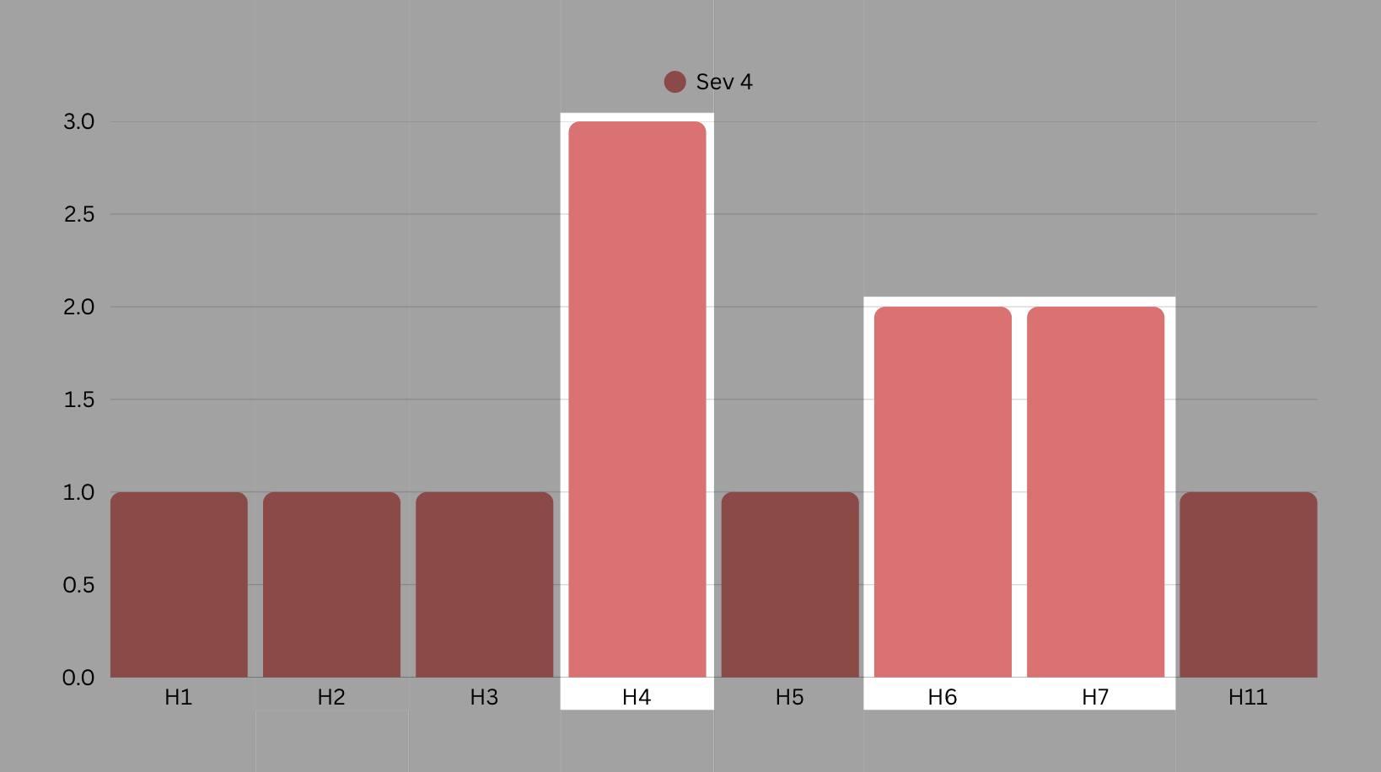
Frequent violations (7)
Severity 4 trends
H4: Consistency
  Ensure all of the buttons indicating the same action have the same wording.
  Ensure that the process of adding sparks is consistent.
H6: Recognition not recall
  Make it clear the format options for the AI organization feature.
H7: Flexibility & Efficiency of use
  Ensure that user can easily identify and add the list of media inputs.

Slide 12
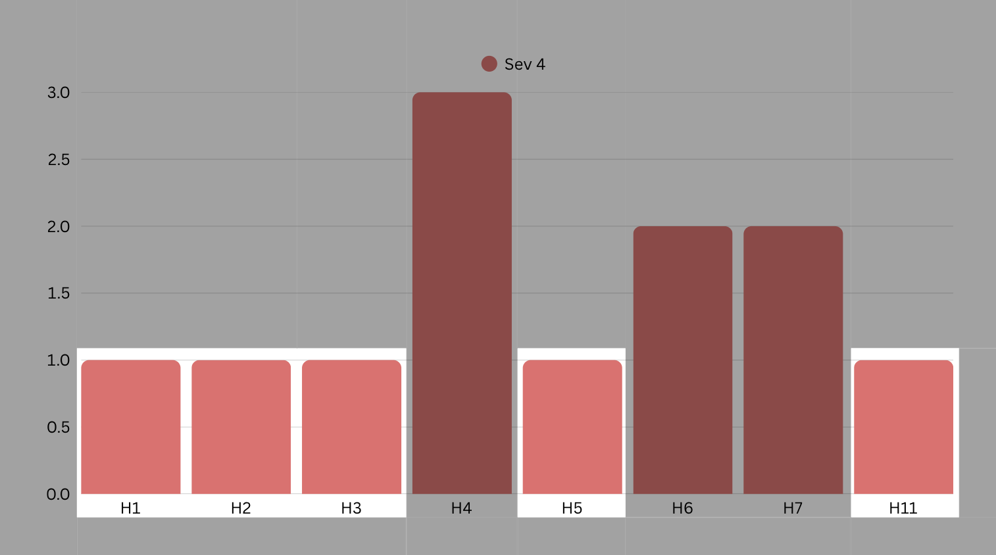
Individual changes (5)
Severity 4 trends
Indicate what texts are editable
Increase the size of elements to be more visible in the screen
Ability to delete sparklettes
Ability to cancel/delete uploads when sharing to the community

Slide 13
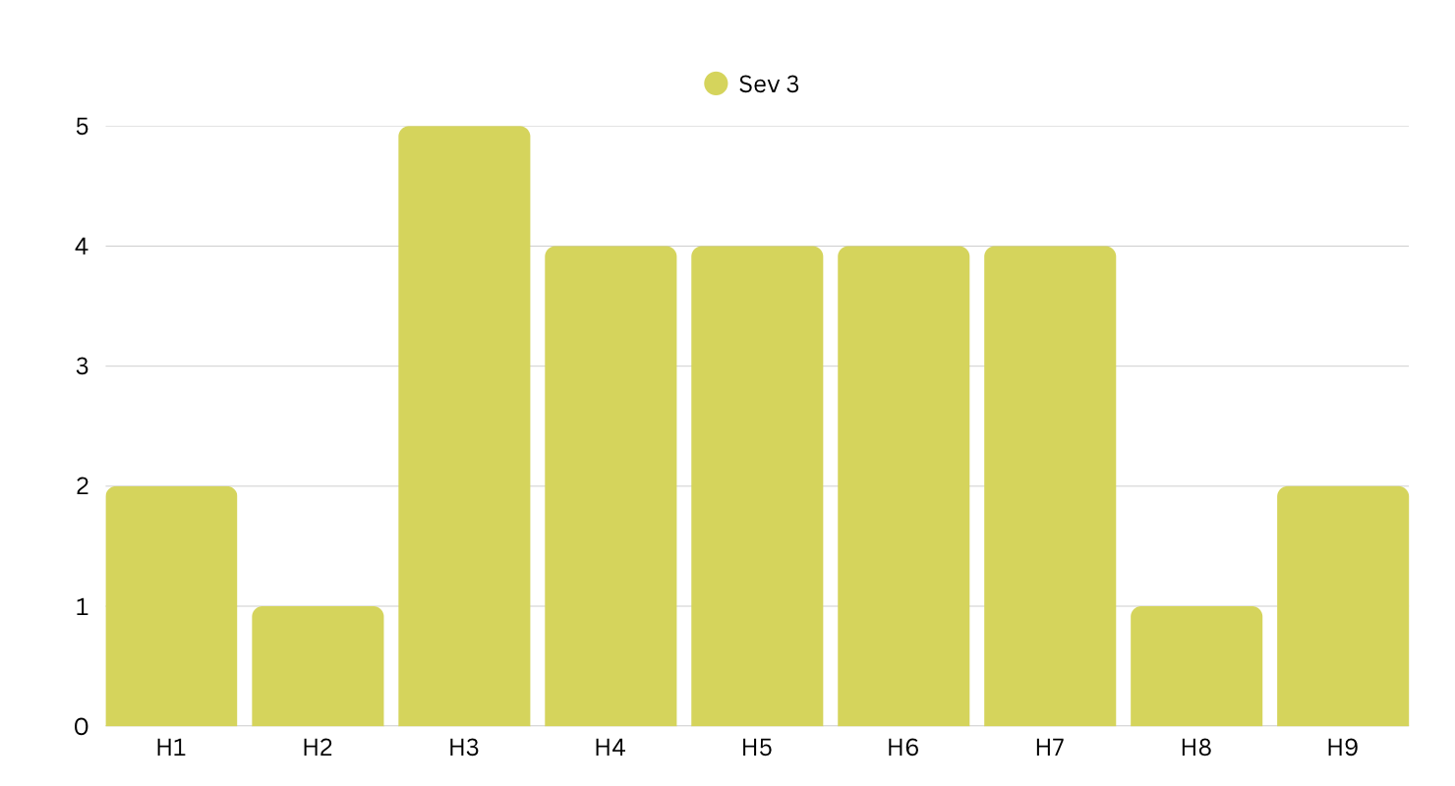
Severity 3 trends
Severity 3
29

Slide 14
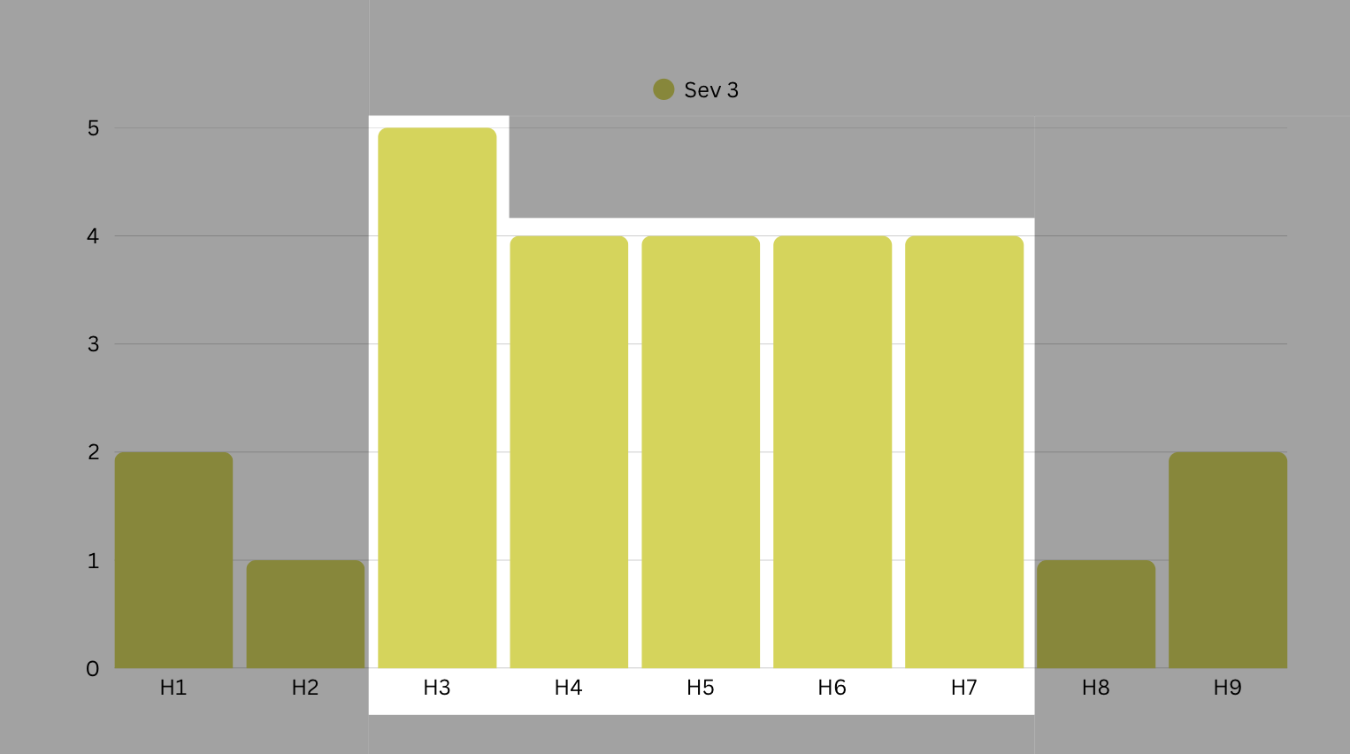
Frequent violations (21)
Severity 3 trends
H3: Control and freedom
  Ensure that users can delete/go back when they’ve done an action.
H4: Consistency
  Ensure that terminology and wording is consistent.
H5: Error prevention
  Ensure that there are error screens for wrong actions.
H6: Recognition not recall
  Make it clear the format options for the AI organization feature.
H7: Efficiency of use
  Make it easy to add many sources at once.

Slide 15
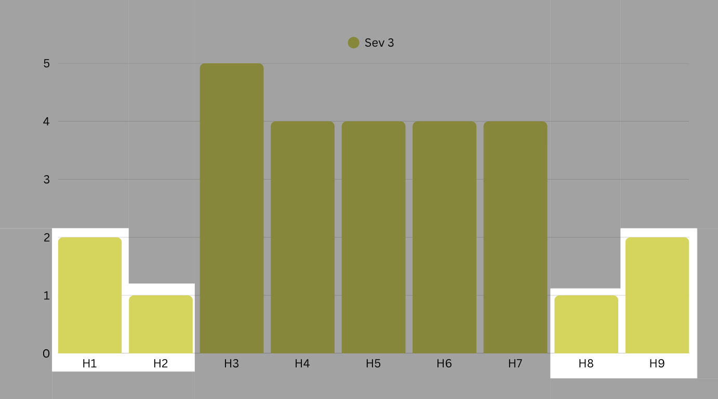
Individual changes (6)
Severity 3 trends
Make it clear which options are optional/mandatory when adding a source.
Clarify the concept of connecting sparks
Add success messages after adding a spark
Include failed upload screens

Slide 16
Key Takeaways
The primary issue was in H4, a lack of consistency in visual aesthetic and terms. This appeared in the prototype in instances such as:
Terms like Sparklette, Board, and Connection were inconsistently defined
Visual inconsistency of sparks on the community page
Buttons labels varying from “Add” vs “Next” vs “Save”
Additionally, there were issues of user control and flexibility (H3 + H7). Throughout different workflows, there is a lack of back, cancel, and delete options. Workflows that need revision are:
Deleting a Sparklette
Undoing a change on the Sparklette
Making a spark public

Slide 17
Revised UI Designs

Slide 18
Usability goals
Flexible: able to accommodate different artists’ workflows, taking into account different sources of inspiration and organization preferences.
Accept different medium inputs in the upload menu
Customizable free form organization on the Sparklette
Interactable elements from within Sparklette to support artists’ organization
  Linking sparks on a sparklette
  Saving songs as lyrics, album cover, or just the title
Efficient: The user is able to easily perform key tasks throughout the app
Adding a spark must be accessible on any screen
Streamlining the process of adding a spark within the project already to reduce clicks needed to add it
Leverage AI to perform smart organization on sparks

Slide 19
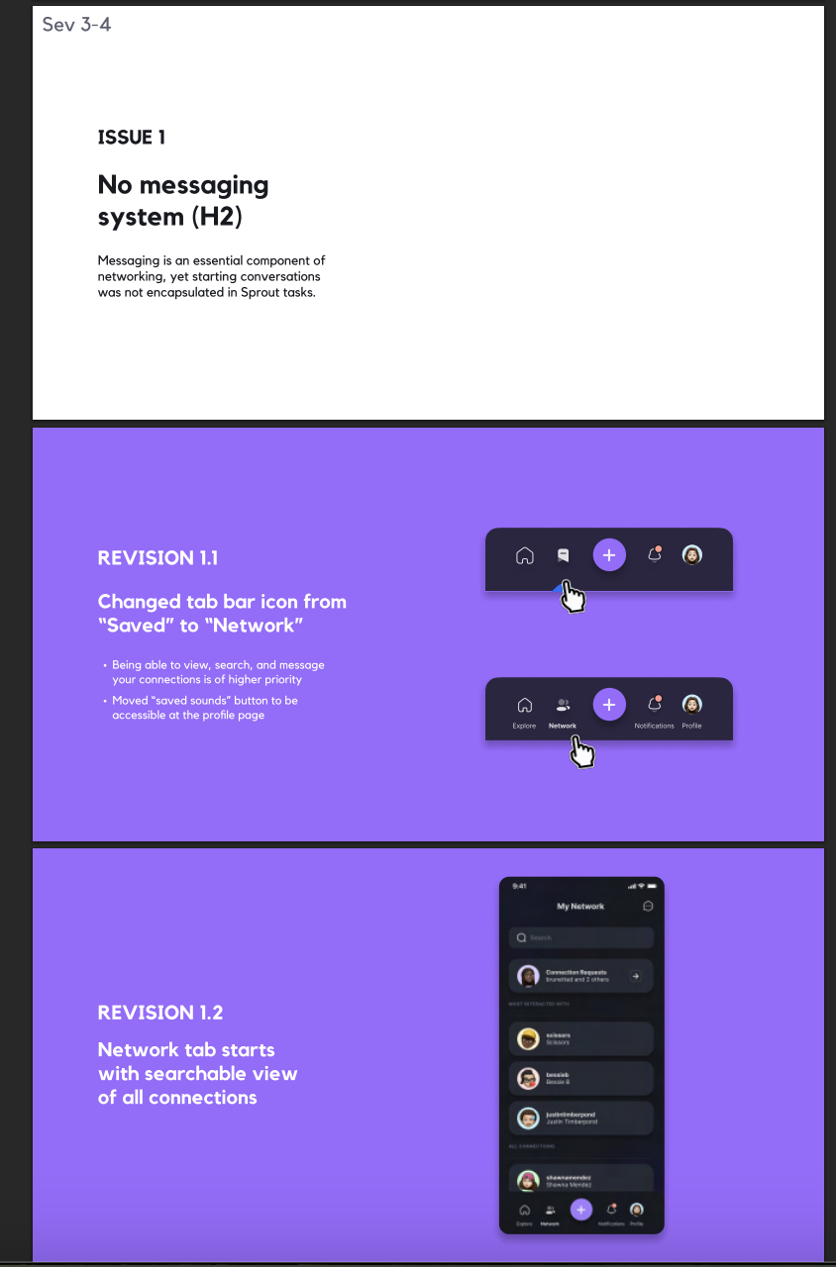
SEV 3-4
Issue 1
Discuss and justify changes to address all severity 3 and 4 violations i. Violations should be clearly connected to the changes made in part 6. Consider using visuals to explain specific issues.
H1: There is no indication whether a text is editable or not.
Giving a recording a name when adding a recording has no indicator that the name of the recording is editable

Slide 20
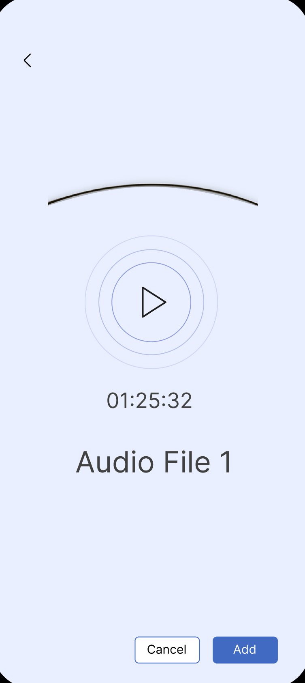
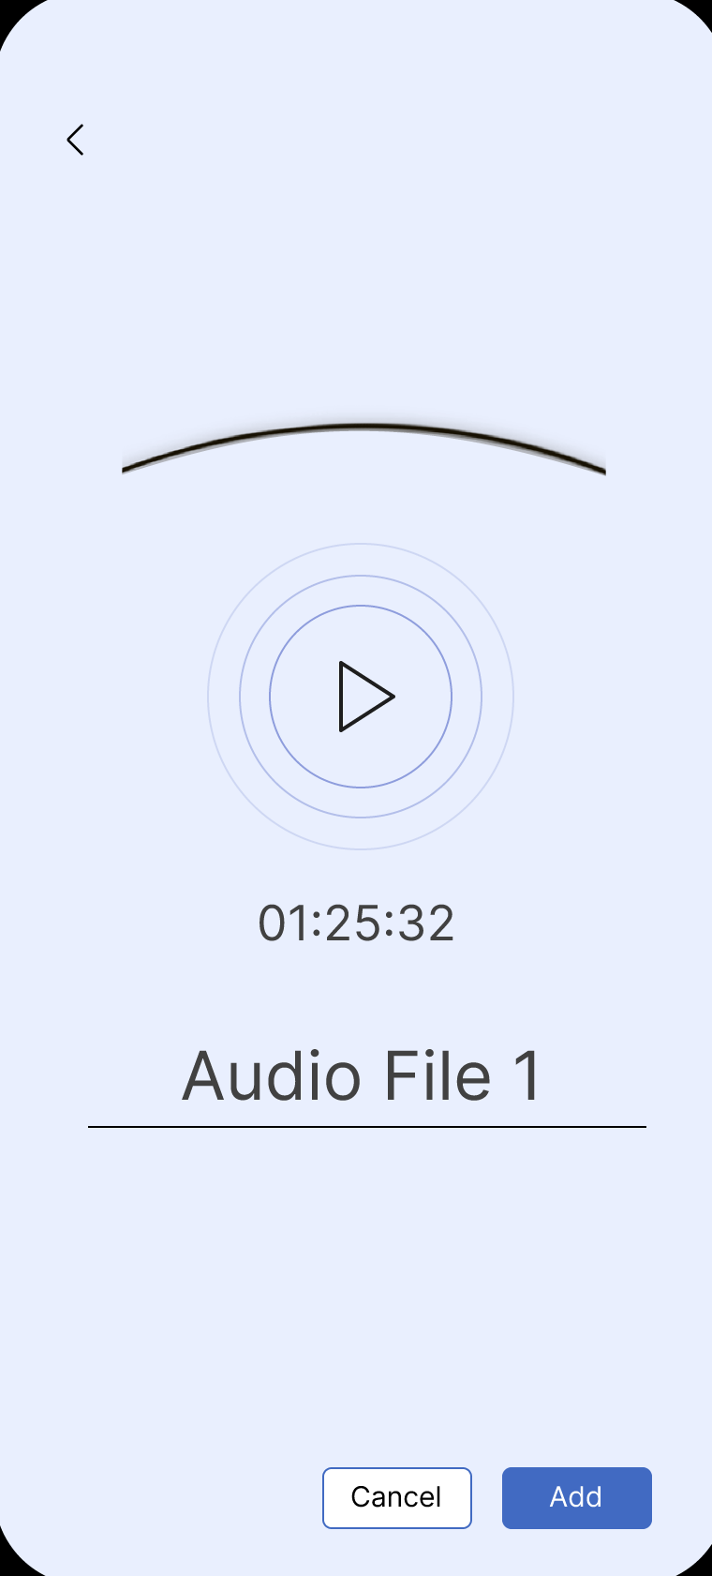
Revision
Before and after shots b. Rationale for changes c. Progress towards each usability goal made by the revised designs. Discuss the impact of the progress made on design values, project next steps, and/or overall success metrics.
Before
After
Added a line under the default text
This makes it clearer to the user that the text can be edited while still maintaining a clean aesthetic.
Aligns with our goal of flexibility: Users are able to edit the names of their multimedia sources.

Slide 21
SEV 4
Issue 2
Discuss and justify changes to address all severity 3 and 4 violations i. Violations should be clearly connected to the changes made in part 6. Consider using visuals to explain specific issues.
H3: No ability to undo/cancel
Users are not able to cancel/undo actions that they do within the sparklette (such as organizing with AI).

Slide 22
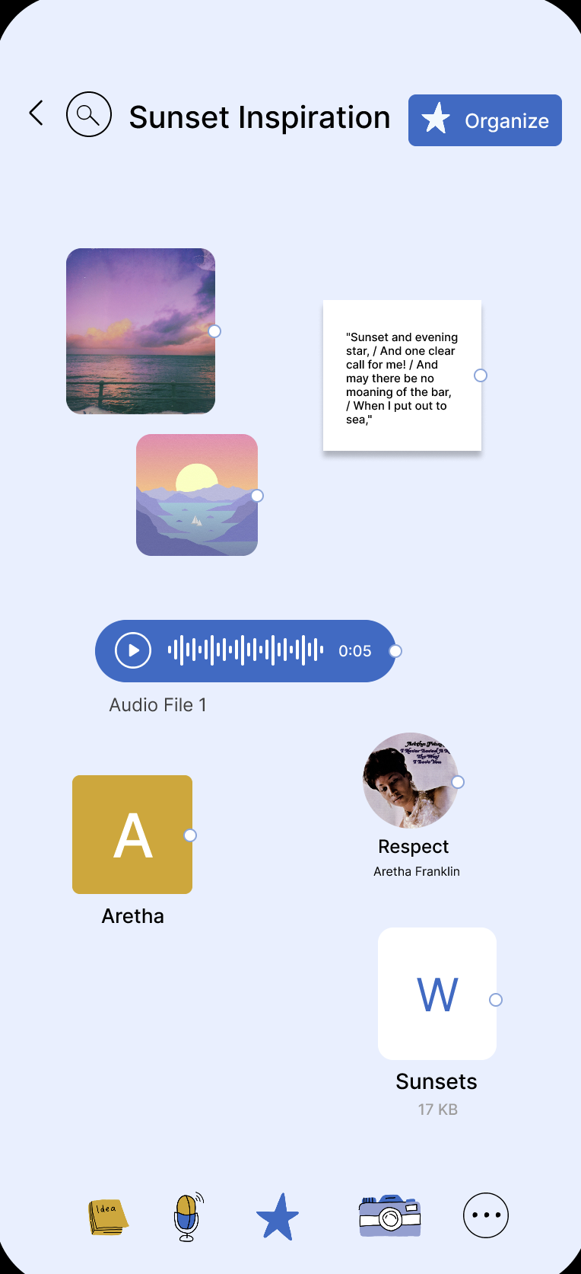
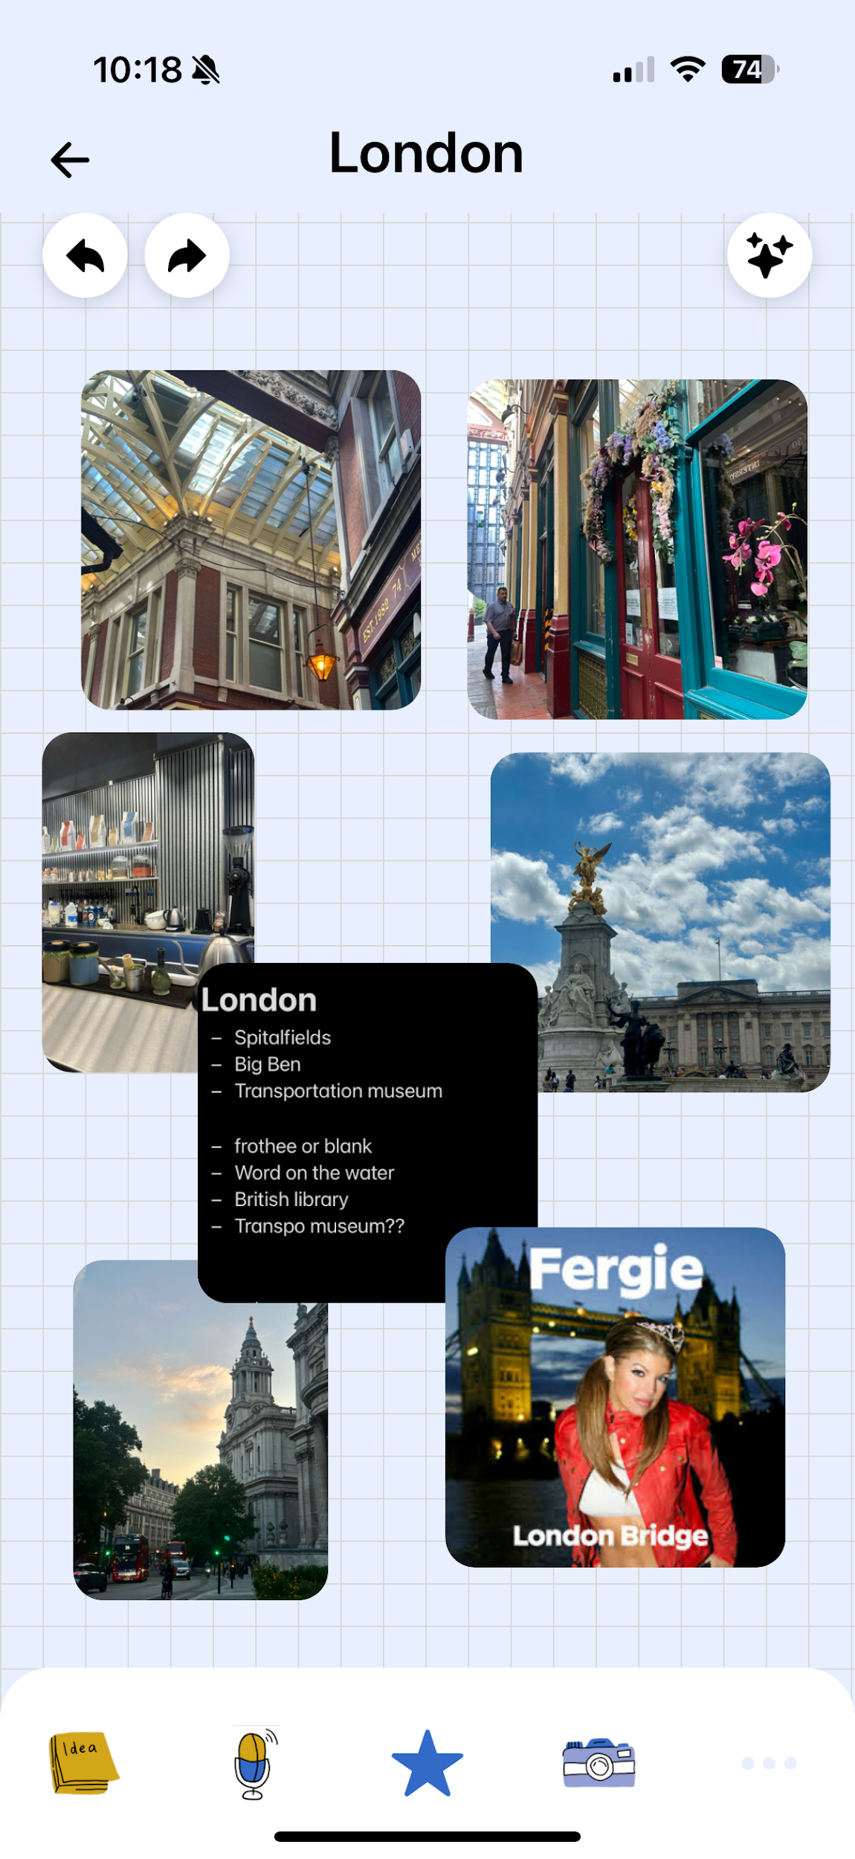
Revision
Before and after shots b. Rationale for changes c. Progress towards each usability goal made by the revised designs. Discuss the impact of the progress made on design values, project next steps, and/or overall success metrics.
Before
After
Added a back and forward button
This makes it easy for users to undo their actions within the sparklette.
Aligns with our goal of flexibility: Users are able to easily go back and forth between their actions within the

Slide 23
SEV 4
Issue 3
Discuss and justify changes to address all severity 3 and 4 violations i. Violations should be clearly connected to the changes made in part 6. Consider using visuals to explain specific issues.
H3: Delete feature
Doesn't allow users to delete Sparklettes they don't want to keep

Slide 24
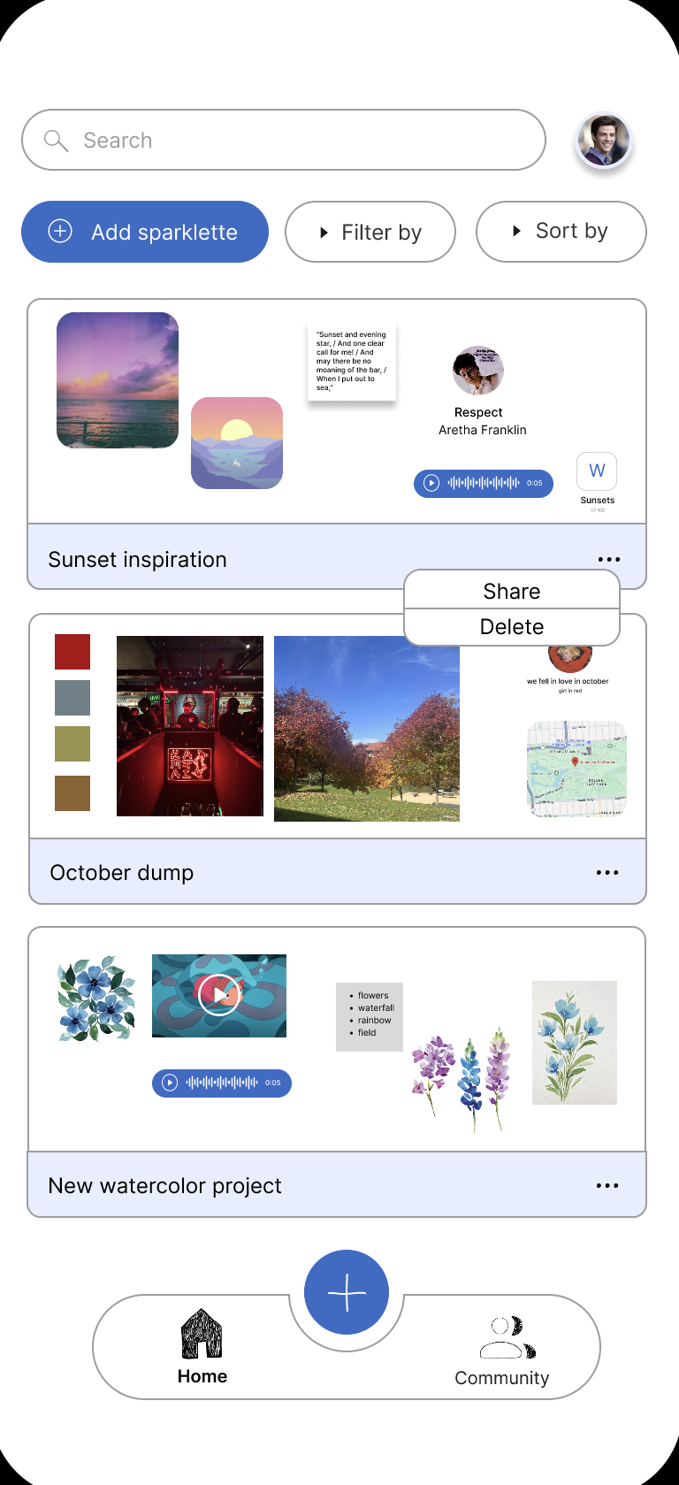
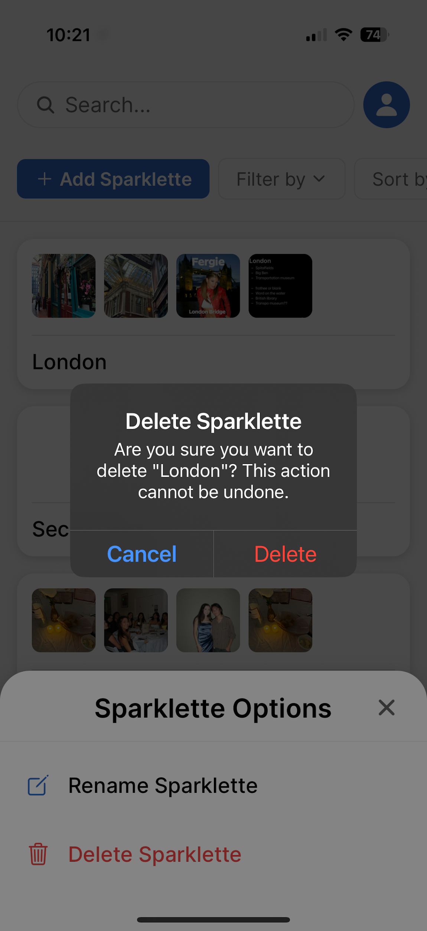
Revision
Before and after shots b. Rationale for changes c. Progress towards each usability goal made by the revised designs. Discuss the impact of the progress made on design values, project next steps, and/or overall success metrics.
Before
After
Added a delete option in the sparklette
Allow users to delete the sparklette and asks them to confirm their action.
Aligns with our goal of flexibility: Users can decide what sparklettes they want to keep or not.

Slide 25
SEV 4
Issue 4
Discuss and justify changes to address all severity 3 and 4 violations i. Violations should be clearly connected to the changes made in part 6. Consider using visuals to explain specific issues.
H4: Inconsistent text when adding a inspiration source
From within a sparklette, adding a photo uses "Next" to submit it, whereas other media forms use "Add" buttons to submit

Slide 26
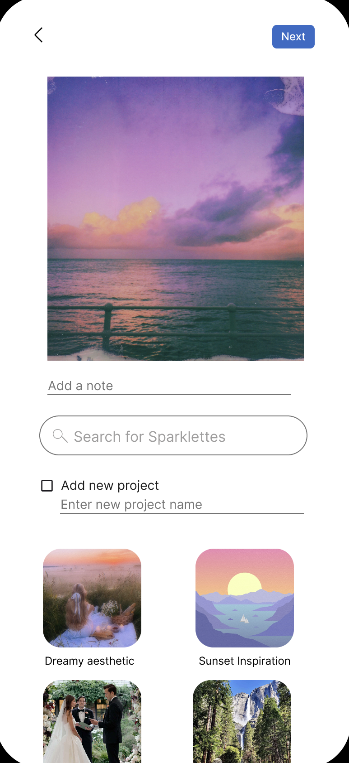
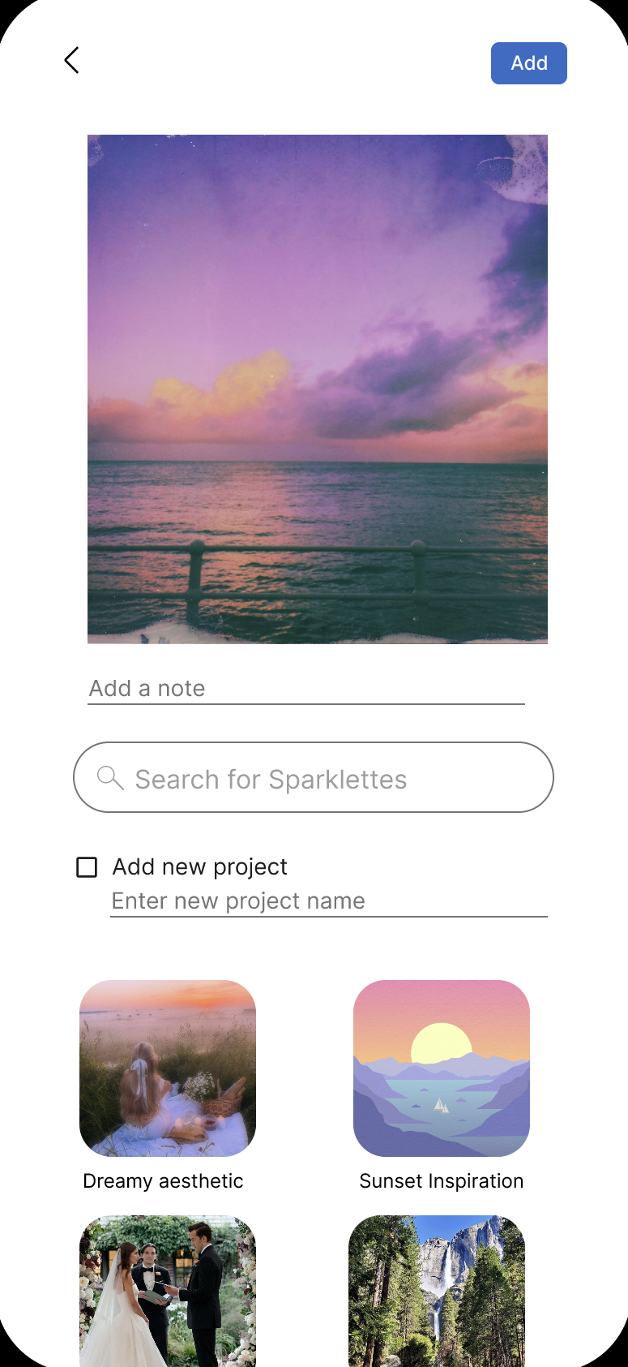
Revision
Before and after shots b. Rationale for changes c. Progress towards each usability goal made by the revised designs. Discuss the impact of the progress made on design values, project next steps, and/or overall success metrics.
Before
After
Changed the “Next” and “Save” button to “Add”
This makes the app more consistent and cohesive.
Aligns with our goal of efficiency: Users can understand how to add an inspiration source without being confused at the difference in wording.

Slide 27
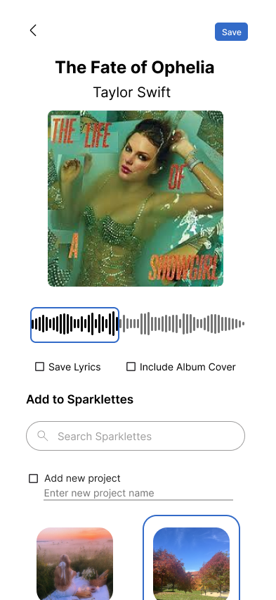

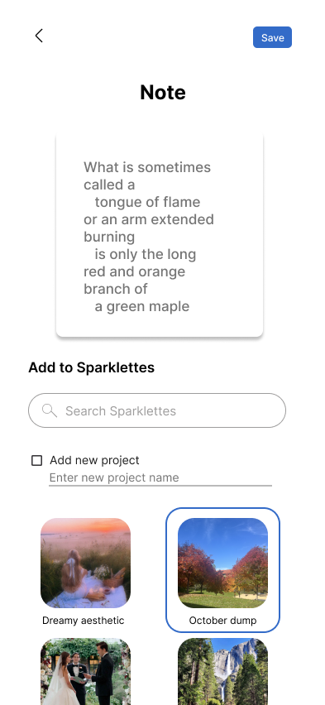

Revision
Before and after shots b. Rationale for changes c. Progress towards each usability goal made by the revised designs. Discuss the impact of the progress made on design values, project next steps, and/or overall success metrics.
Before
After
Before
After

Slide 28
SEV 3
Issue 5
Discuss and justify changes to address all severity 3 and 4 violations i. Violations should be clearly connected to the changes made in part 6. Consider using visuals to explain specific issues.
H4: Visual consistency in the community page
There is a lack of consistency between the different updates on the feed and it can be confusing to understand that all updates on the feed serve the same purpose.

Slide 29
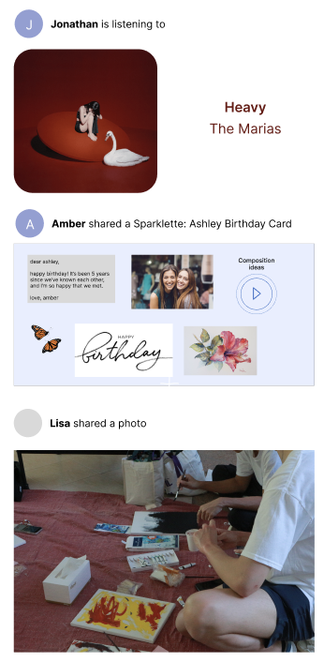
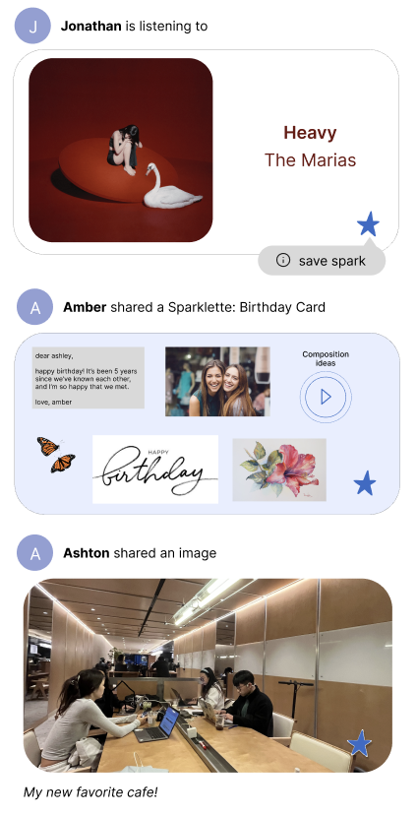
Revision
Before and after shots b. Rationale for changes c. Progress towards each usability goal made by the revised designs. Discuss the impact of the progress made on design values, project next steps, and/or overall success metrics.
Before
After
Consistent rounded corners and visual cues across inputs
This allows for clear recognition of a post made in the community as all types of media are bound by a rounded rectangle
Improves aesthetic and recognition for users

Slide 30
SEV 3-4
Issue 6
Discuss and justify changes to address all severity 3 and 4 violations i. Violations should be clearly connected to the changes made in part 6. Consider using visuals to explain specific issues.
H7: The add menu does not have all of the input options available + too many words
When clicking the add button, a menu with the input options appears, but it does not have all of the options that are provided in the app, and it is text heavy.

Slide 31
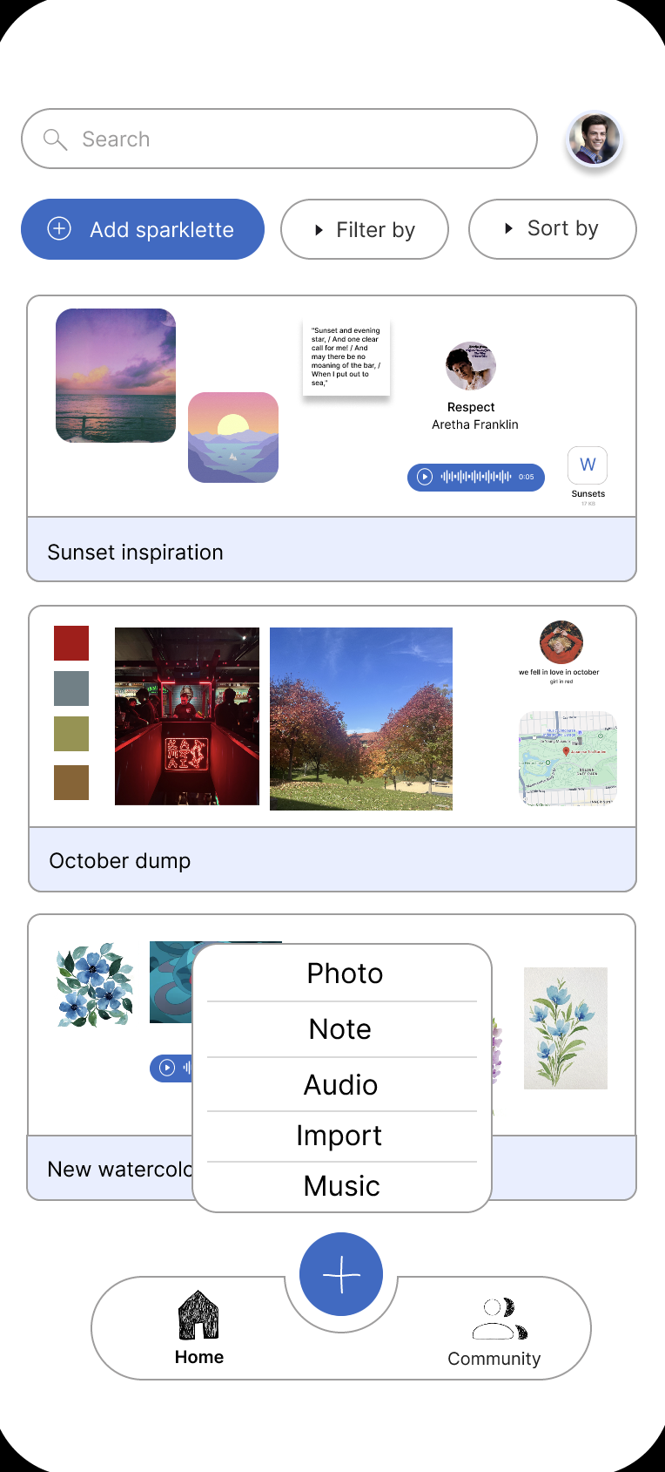
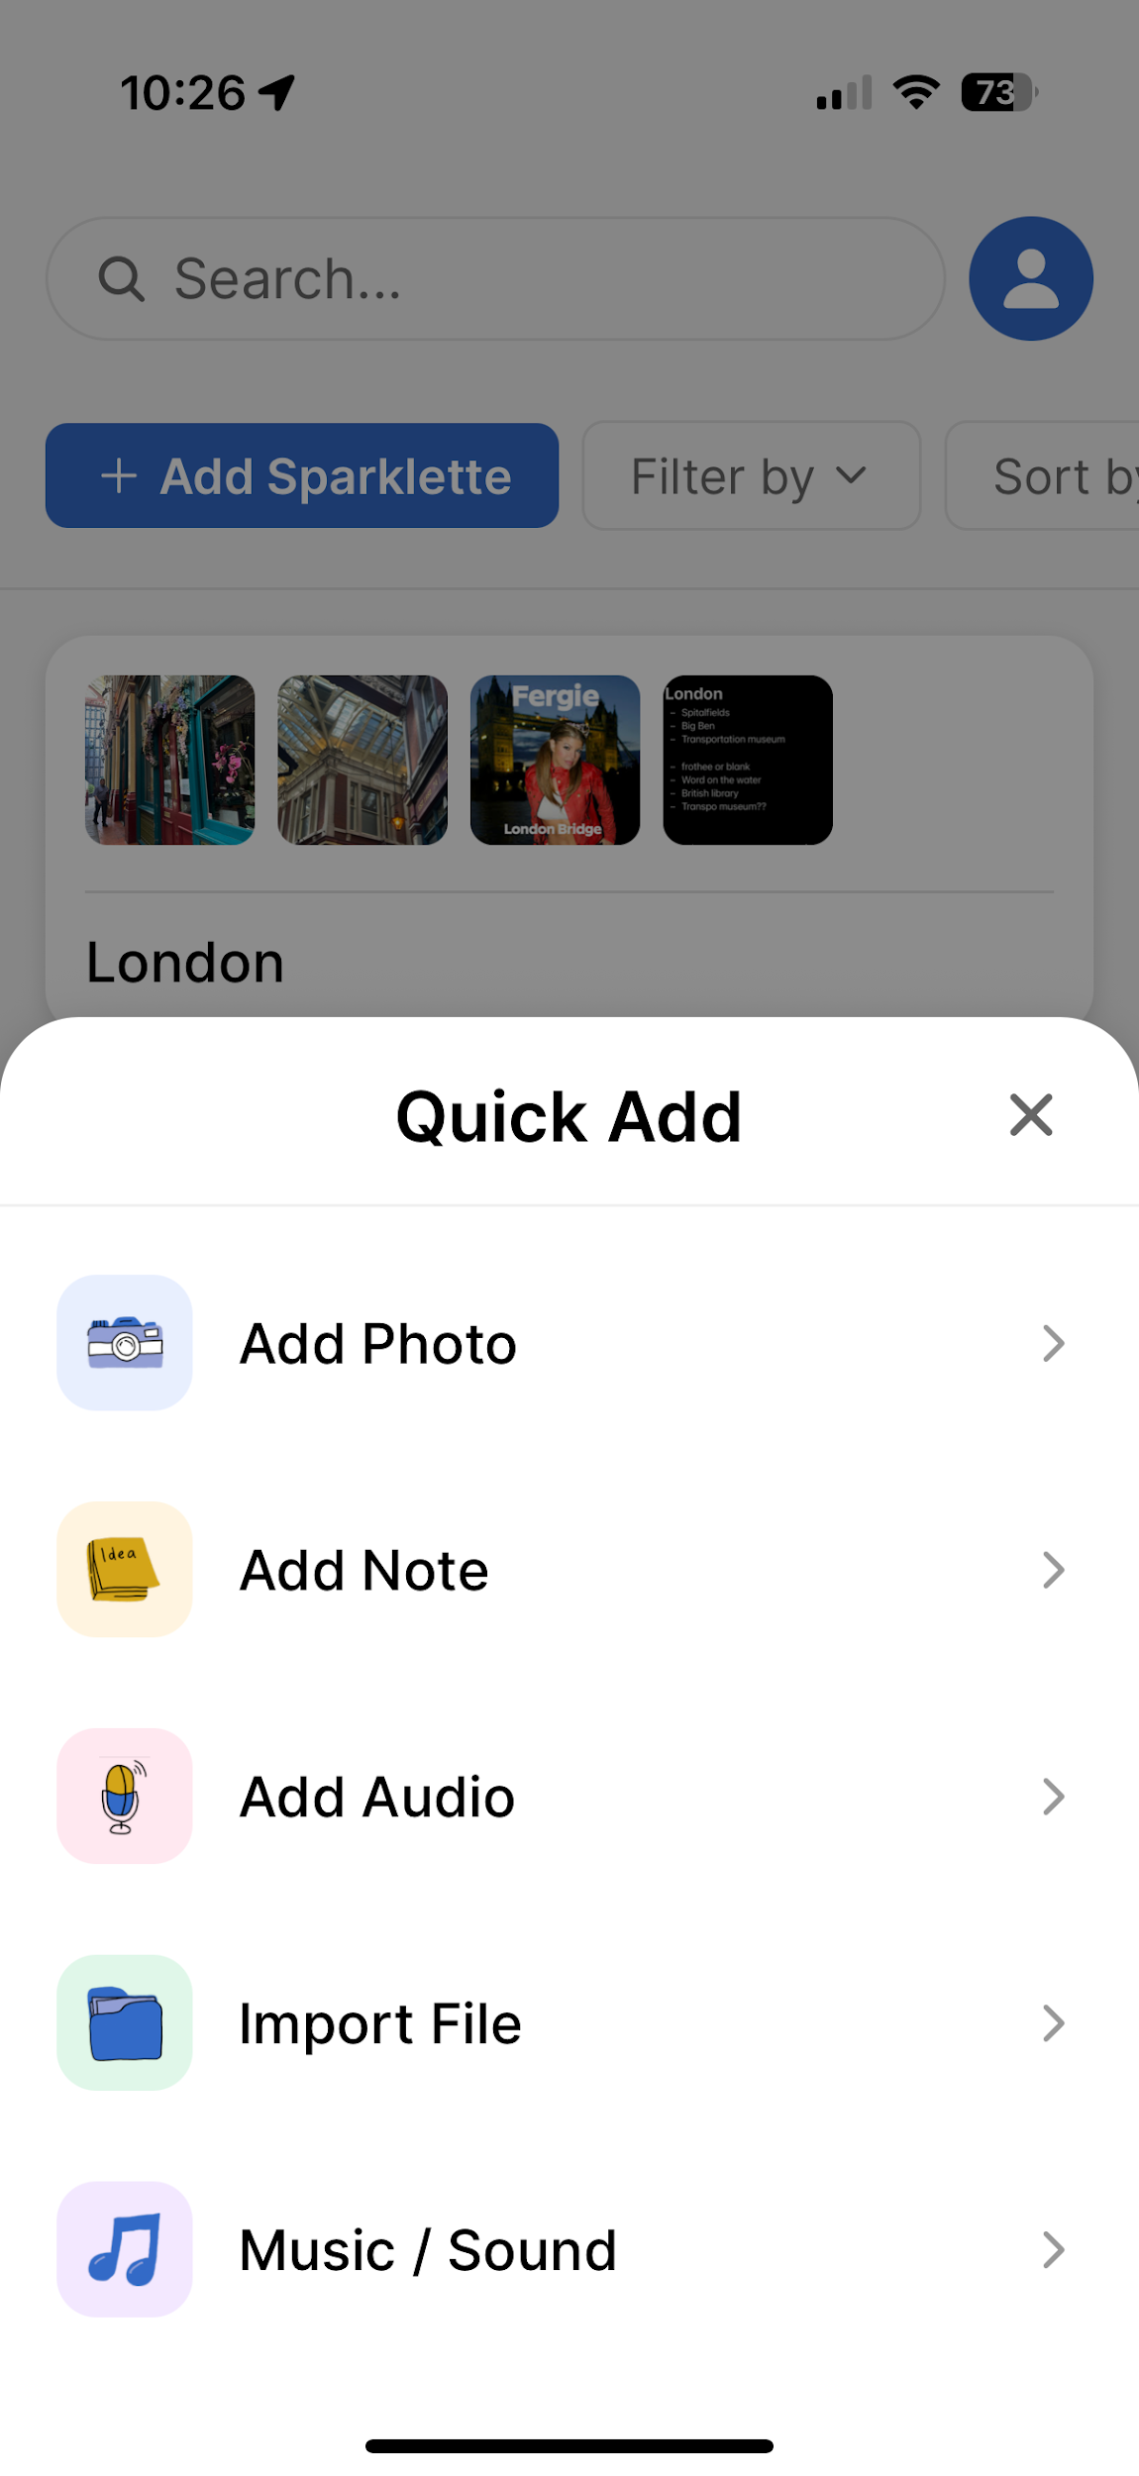
Revision
Before and after shots b. Rationale for changes c. Progress towards each usability goal made by the revised designs. Discuss the impact of the progress made on design values, project next steps, and/or overall success metrics.
Before
After
Changed the overlay to display the icons and text.
This is now consistent with all of the media options users can add to the app.
It is also easier and quicker to see which input you want to add because of the visual cues (icons).
Aligns with our goal of efficiency: Users are able easily and efficiently add their sources of inspiration.

Slide 32
SEV 4
Issue 7
Discuss and justify changes to address all severity 3 and 4 violations i. Violations should be clearly connected to the changes made in part 6. Consider using visuals to explain specific issues.
H7: Saving a public spark to your own Sparklette
It's unclear how to save media from the community in a way that's more efficient than screenshotting/recording

Slide 33
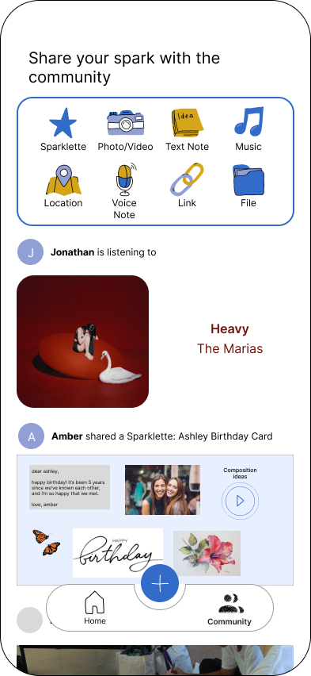
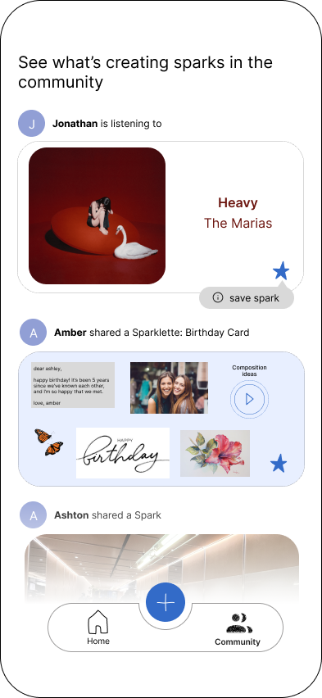
Revision
Before and after shots b. Rationale for changes c. Progress towards each usability goal made by the revised designs. Discuss the impact of the progress made on design values, project next steps, and/or overall success metrics.
Before
After
Added a quick save spark button to the community page
This introduces a quick way to save a spark to your own Sparklette in a few clicks
Having a clear pop up for onboarding to show what the icon means, will allow for recognition over recall
Aligns with our goal of efficiency: Users are able easily and efficiently save sparks from others.

Slide 34
Hi-Fi Prototype & Demonstration

Slide 35
Tools / Frameworks
React Native + Expo — main app development
React Navigation (Stack + Tabs) — navigation between Home ↔ Sparklette
Supabase — user auth, DB, image storage
Expo ImagePicker — selecting/capturing photos
Animated + PanResponder — for draggable Sparks

Slide 36
Wizard of Oz / Hard Coded Items
Wizard of Oz
Notes and Music → actually photos
Infinite scrolling canvas
Suggested sparklette to upload to
No AI-powered tagging or organization yet (randomized locations on sparklette)
Hard-Coded
Spark placement defaults near center with randomized offsets
Spark sizing fixed at 160×160
Note/Audio/File/Music “actions” hard-coded as placeholders
Justification: simulate complete user experience while postponing features that require more time or deep backend work
Notes:
Wizard of oz justification: These allow us to simulate the complete user experience needed for the usability study while postponing features that require more time or deep backend work.

Slide 37
Implemented Features
Simple Task:
Quick add menu
Add photo to a sparklette
Take photo or add from library
Edit photo properties (name, size, delete)
Scrolling Canvas
Drag photos to organize
General
Supabase: auth, database, storage
Login screen
Error messages + placeholder screens for unimplemented features (“coming soon!”)

Slide 38
Unimplemented Features
Photo-flow polish
Compression
Loading indicator
Edit details after upload
Other spark types
Note
Audio
Import file
Music/sound
Community page
UI not built
Will use hard-coded posts
Navigation polish
Better transitions
Contextual Quick Add behavior
Undo/Redo behavior

Slide 39
Progress + Plans to Finish
End of Break:
Task 3
All types of sparks
Fully fleshed out sparklette
Stretch Goals
Onboarding
Smart Sorting
Faster data storage + retrieval
Today:
Login
Task 1
Add/delete sparklettes
backend
End of Week 10:
Task 2 (Social)
Fully Polished UI

Slide 40
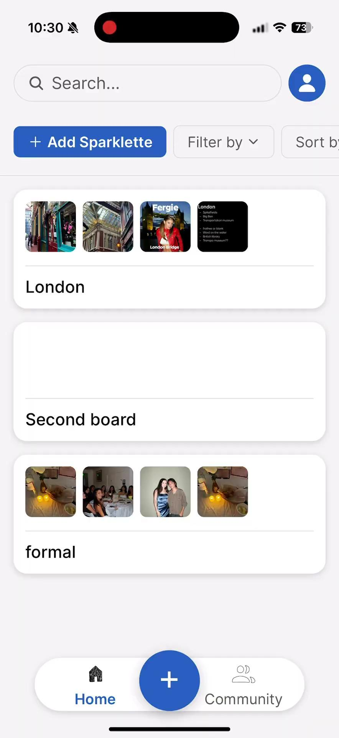
Demo Video

Slide 41
Thank you!

Slide 42
Appendix

Slide 43
Use of AI
Code Assistance:
Used AI to aid in complex React Native and Supabase implementation (draggable components, database structure).
Visual & UI Help:
AI helped refine layout ideas across platforms and ensure consistent styling based on our own custom style guide (no assets generated by AI).
Why It Was Appropriate:
Sped up boilerplate + debugging.
Let us focus on core interaction + design decisions.
All key UX + logic decisions were human-driven.

Slide 44
SEV 3
Additional Issue 1
Discuss and justify changes to address all severity 3 and 4 violations i. Violations should be clearly connected to the changes made in part 6. Consider using visuals to explain specific issues.
H5: Users can only type in their password once
When creating an account, users only have to type password once, providing a potential for error

Slide 45
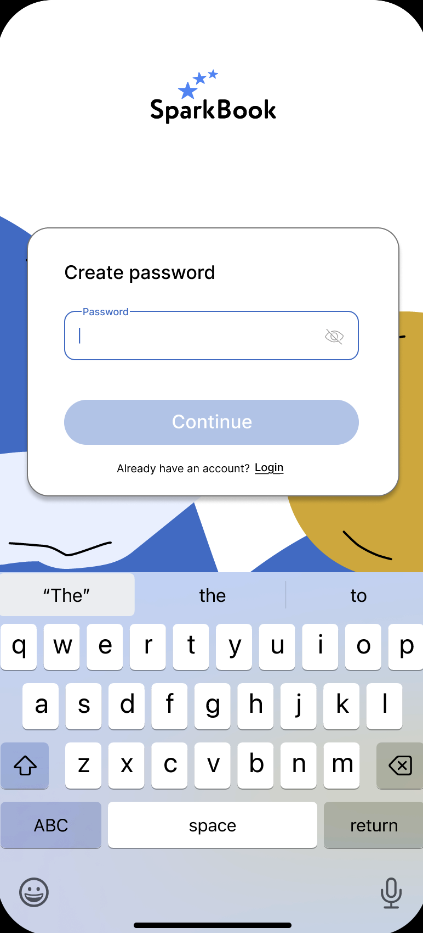
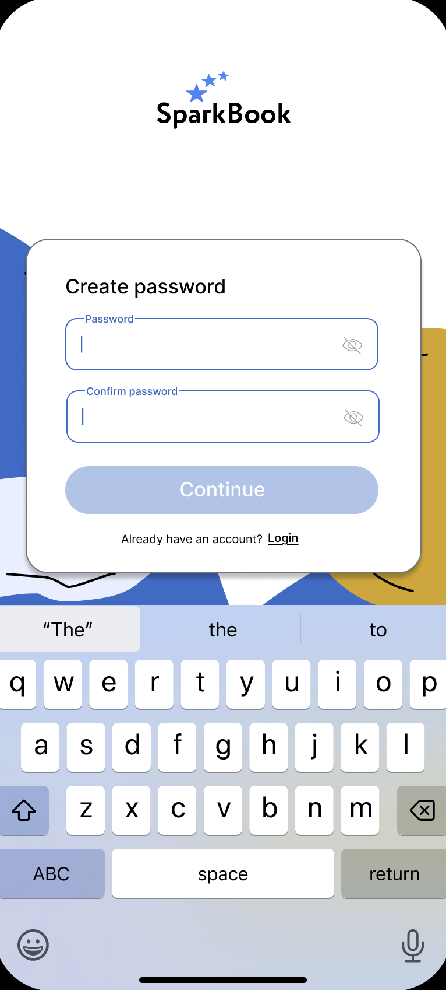
Revision
Before and after shots b. Rationale for changes c. Progress towards each usability goal made by the revised designs. Discuss the impact of the progress made on design values, project next steps, and/or overall success metrics.
Added a confirm password section
This avoids the issue of users mistyping their password.

Slide 46
SEV 4
Additional Issue 2
Discuss and justify changes to address all severity 3 and 4 violations i. Violations should be clearly connected to the changes made in part 6. Consider using visuals to explain specific issues.
H5: Can't cancel or delete upload
Doesn't allow users to cancel or delete uploads when they're sharing to community

Slide 47
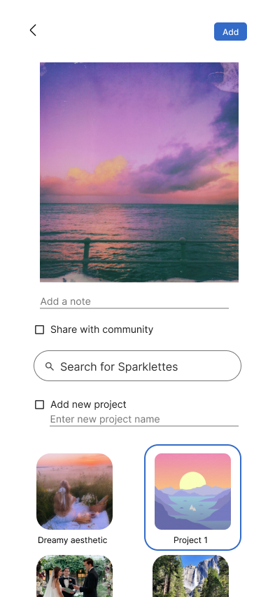
Revision
Before and after shots b. Rationale for changes c. Progress towards each usability goal made by the revised designs. Discuss the impact of the progress made on design values, project next steps, and/or overall success metrics.
Upon entering the settings of each spark, one can edit the share with community status
This allows users to go back to sparks and more efficiently share with the community
Aligns with our goal of efficiency: Users are able easily and efficiently share their sources of inspiration.
Aligns with our goal of flexibility: Users can edit the public status at anytime.

Slide 48
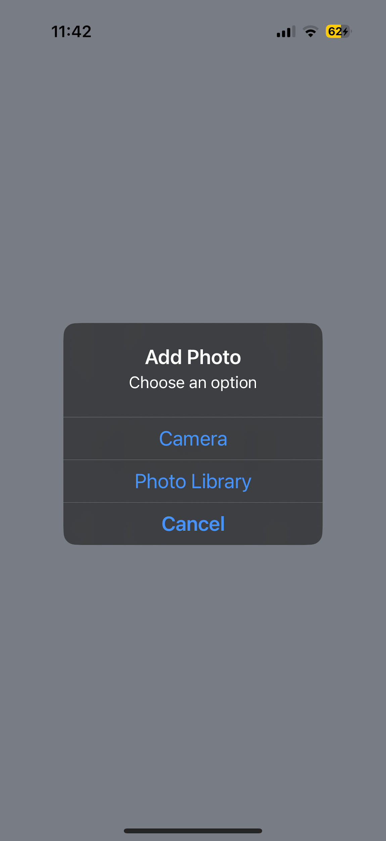
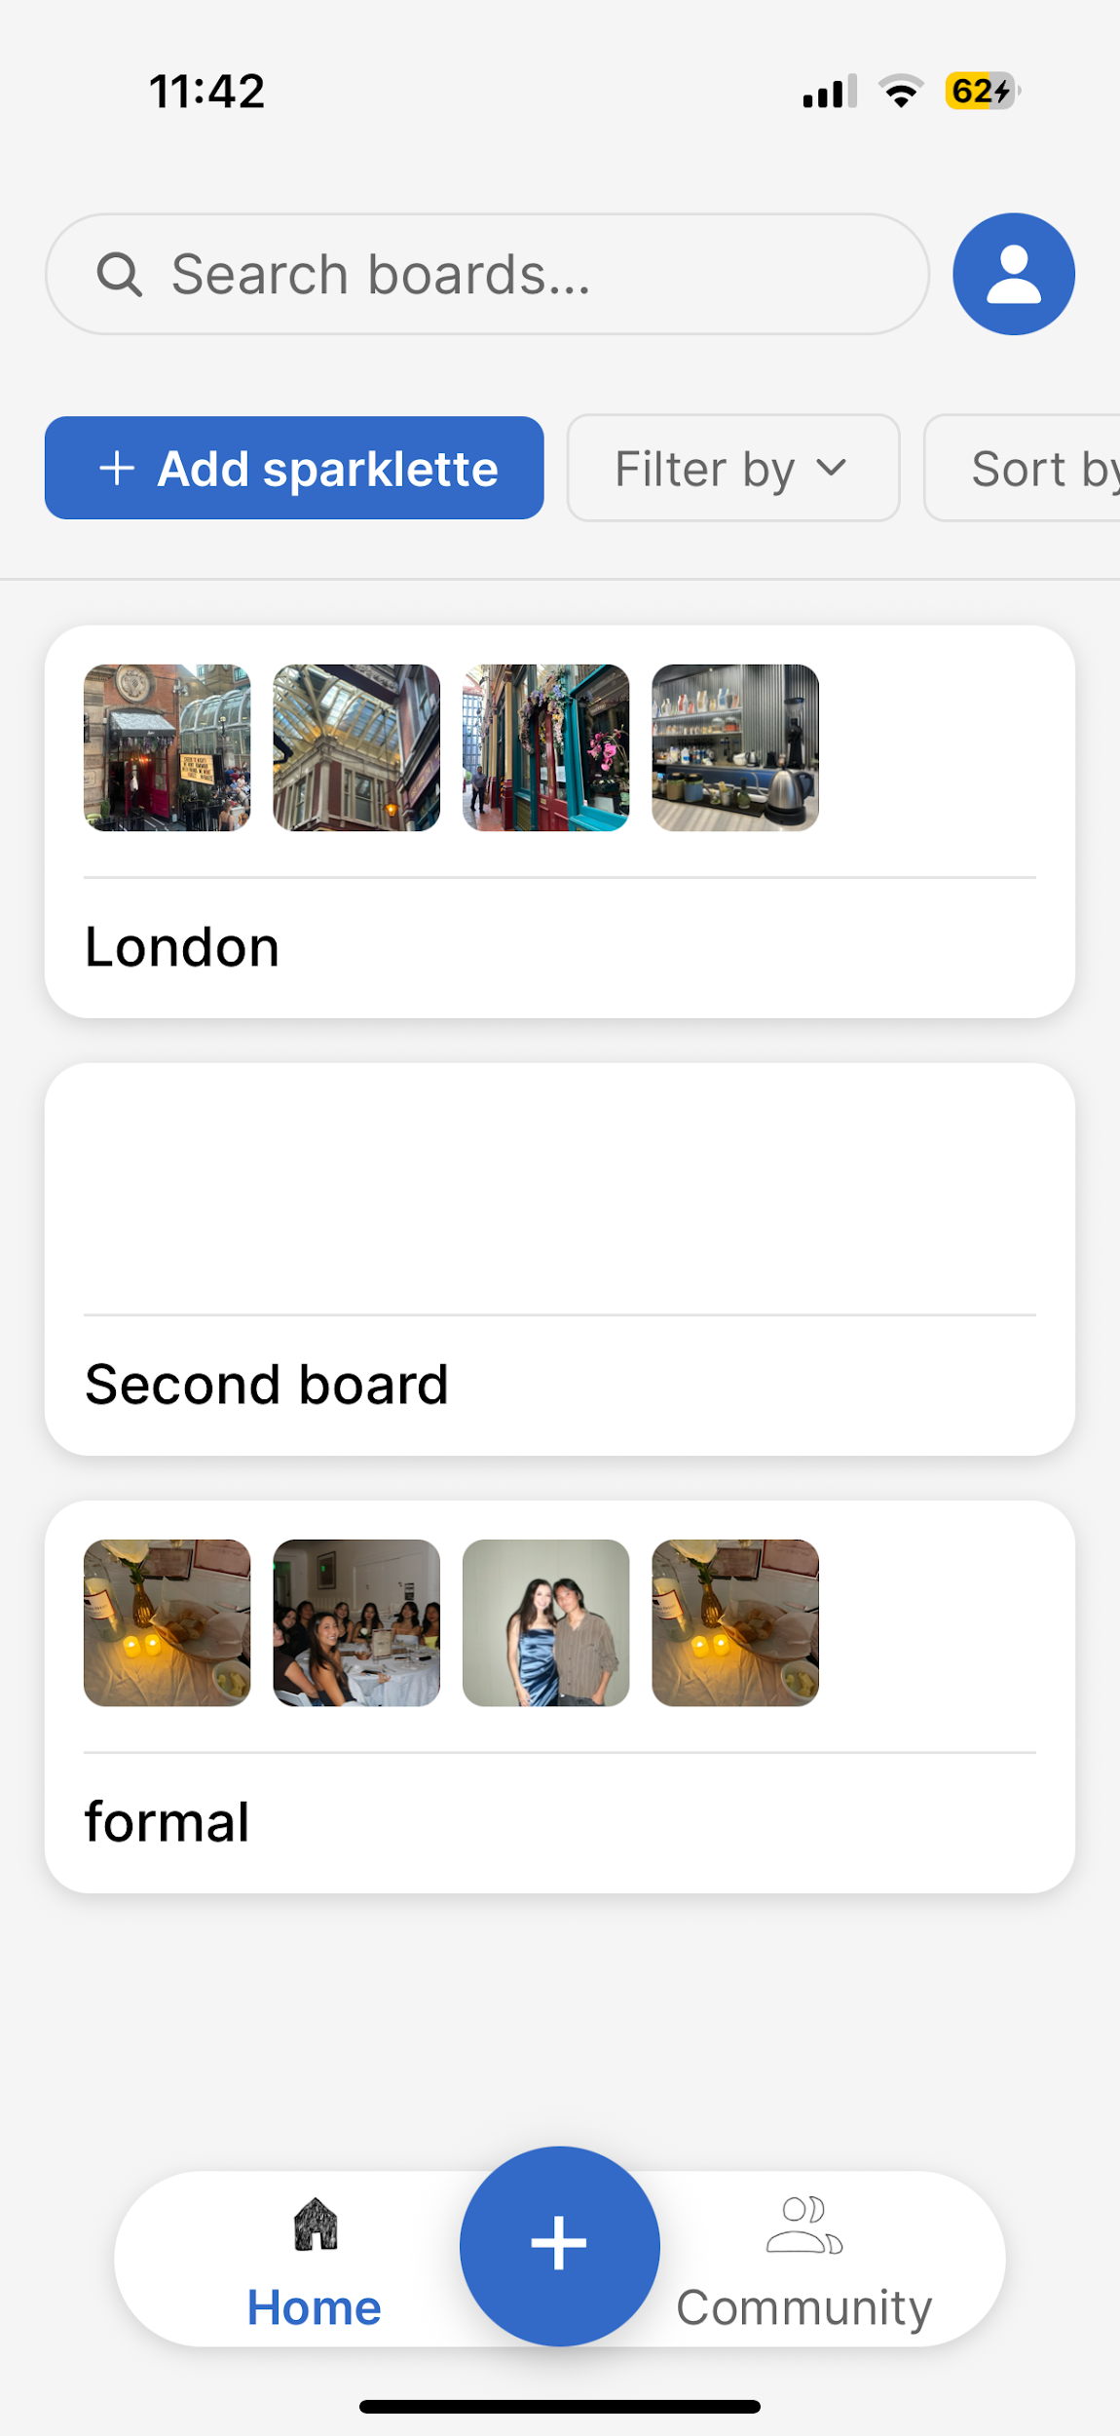
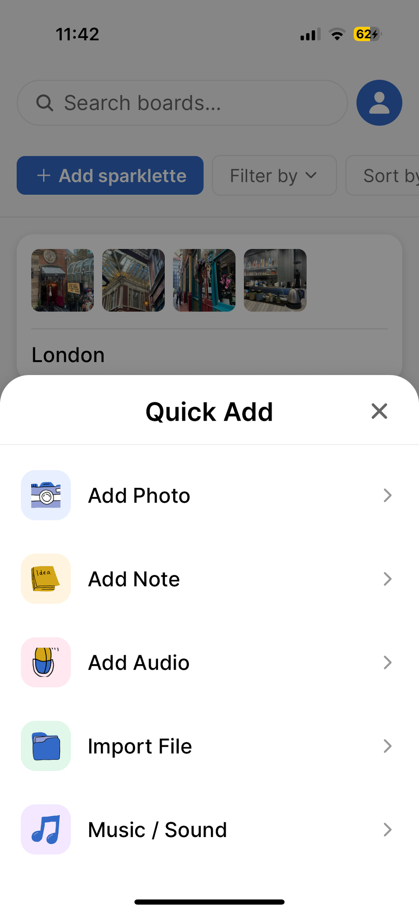
Simple Task → Adding an Image

Slide 49
